Slide 1


TRESURETROVE: Money Control
Milestone 2 – Final Presention
Data & Knowledge Engineering Group
4. July 2021
LAKSHMI HARIKA NAKKA (Scrum Master/Developer/ Functional Testing)
MIMRAZ HASSAN (Weekly Reports)
MUHAMMAD FAIZAN ASLAM (Blog Maintanence)
VENKATA SUBBA RAJU KANUMURI (Developer & Implementation)
PRESENTED BY: Venkata Subba Raju Kanumuri

Slide 2

Overview
Requirement Analysis
Behavioral Modeling
Testing
Prototype Demo
Requirement formulation, analysis and mapping to user stories
Modeling process and workflow using Use-Cases and Activities
Dedicated UI/Functional testing & Bug fixes
Presenting a working prototype
AdvancePrototype
Structural Modeling
Implementation
Static modeling using classes, attributes and static relationships
Method of implementing required features, UI, layouts and testing performance
2
2

Slide 3
WHAT REQUIRMENTS OF THE CLIENT WERE ACCOMPLISHED
Necessary Requirements
Icons for transactions, Payment mode
Deleteting an entry, Comments
Date and time with easy to use keyboard
Filters &Classification of transaction
Login ID & Autentication
Offline Mode Operation
Exporting Data to excel file
Support from the developers
Essential Requirements
Deleting & Editing an entry
Budget Planning
Recurring Transactions
Import and exporting Data
Nice to have Requirements
Represent Data using Graphs and Charts
Help and FAQ Menu
Multiple currency entry/Default currency
Montly/Daily average computation
Multiple Environment (Home/Work)

Slide 4
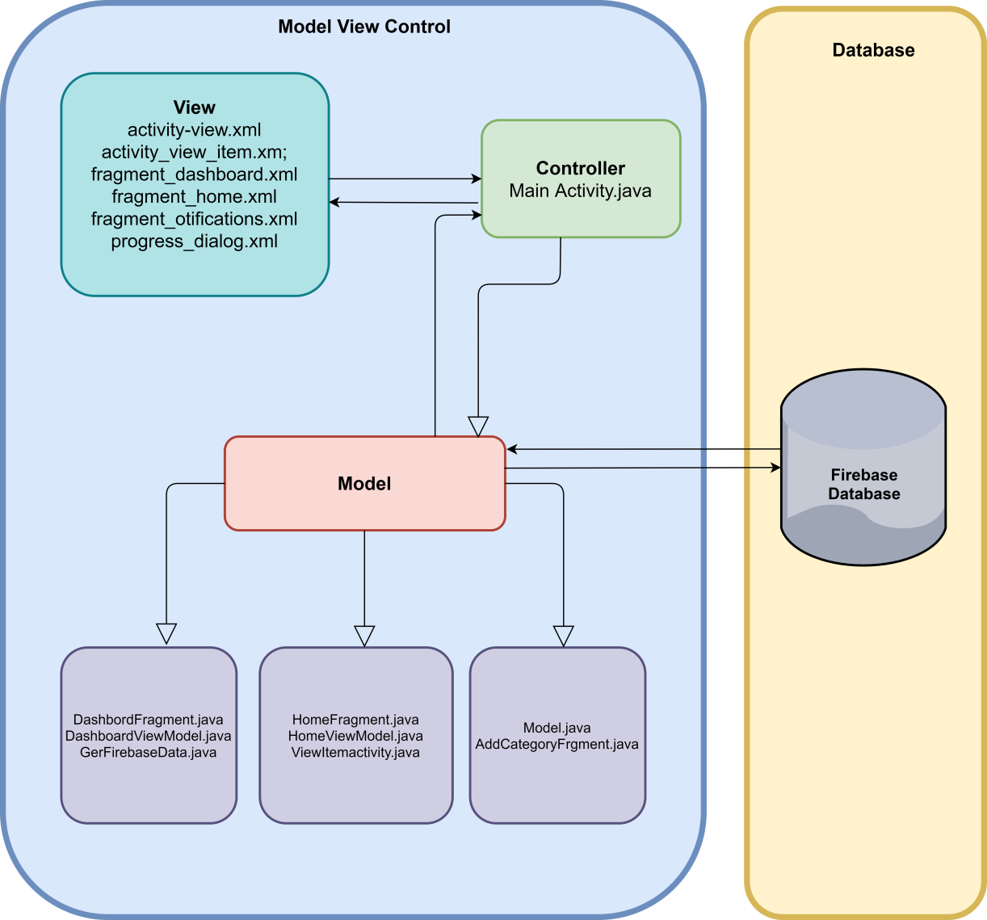
System Architecture
This slide represents the basic architecture of the application
The application consist of an activity view under which we have three fragments
Home, Dashboard and the new transaction
We use java as the programming language and Firebase as our database.

Slide 5
Bug Fixes After Beta Prototype
We have improved The Following:
Visual Representation of the customer data in a form of a pie chart or a graph.
Email and phone number Validation.
Beautification and interface enhancement
Help and FAQ menu to provide an user friendly interface.
Refurbishing our reccuring transactions , Previously which was categorised as favourites.
Functional

Slide 6
Further Scope Of Enhancements
We would further continue working on our application after the deployment.
Accesibility enhancement , Data Privacy enhancment accesing the sensitive data from the client.
Dynamically addition of environments and deleting them according to our requirments.
Simple reccomendations for the user by analysing his spending patterns.
Functional

Slide 7
Working Prototype

Slide 8
Working Prototype

Slide 9
Working Prototype

Slide 10
Working Prototype

Slide 11
Working Prototype

Slide 12
Working Prototype

Slide 13
Working Prototype

Slide 14
Working Prototype

Slide 15
APPLICATION DEMONSTRATION…….
Data & Knowledge Engineering Group
BY :Lakshmi Harika Nakka

